Slide 1
Emotion classification
Made by: Group 3; Neil, Maikel, Shan, Vincent
Notes:
P: Explain 1 kaggle submission
I: Describe the objective of project. (bring issues to standups)
S: Explain Project details, preprocessing, algorithms, evaluation
G: Best and 2 other submissions that led to the best submission. valid reasons for iterations, and discuss expectations
E: Best submission and show personal contribution. clear communication by peer review, constructive feedback to other groups during presentation.

Slide 2
Contents
The Project
Data processing of dataset
Preprocessing of the data
Model Selection
Metrics, Pipeline, Results
Limitations of our models
Conclusion
Notes:
Which person does what:
Vincent: Introduction, Contents, Preprocessing, Limitations
Shan: Model Selection (Final Model), Conclusion
Neil: Project, Data Processing, Metrics and Results, Results pipeline
Maikel: Dataset processing, Model Selection, Pipeline

Slide 3
The Project
NLP
Objective of project
Banijay & 3Rivers

Slide 4
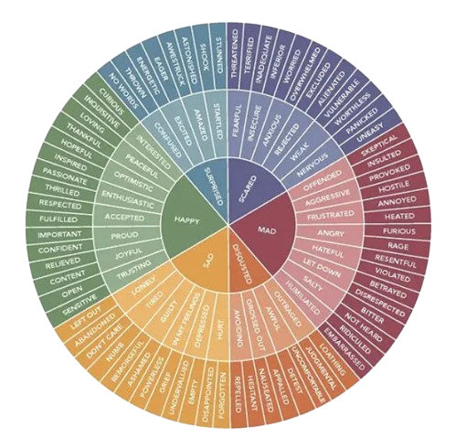
Data Processing: Dataset
SMILE, MELD-master, Friends emotion-labeled dialogues, dailydialog and the CARER dataset.
GoEmotions:
Emotions → Paul Ekman
Notes:
For this project, we need to make a dataset to work with. we got excess to a lot of datasets and from do’s we chose to use SMILE, MELD-master, Friends emotion-labeled dialogues, ijcnlp_dailydialog, CARER, and the GoEmotions dataset. For the main dataset that we used for most of the models. In the later part of the project, we started looking at the datasets again to see if we could improve the model performance by improving what data it was trained on, that is how we ended up only using the GoEmotions dataset for the model. The biggest challenge with the GoEmotions dataset was that it was labeled with 28 emotion categories, we only predicted the core 6 emotions as described by Paul Ekman’s emotion wheel. So, we had to label these 28 emotions as one of the 6 core emotions. Emotions that had no obvious place within those 6 and all the neutral labels were dropped from the dataset.

Slide 5

Preprocessing of the data
Text Cleaning
Stemming
Tokenization
Vectorization
Handling Imbalanced Data
Removing extra data
Notes:
Text Cleaning:
Process: Removing noise and irrelevant symbols from text data.
Importance: Enhances model efficiency by simplifying the data and removing unnecessary distractions.
Stemming:
Process: Reducing words to their root form to standardize variations and reduce redundancy.
Importance: Enhances model efficiency and clarity by condensing words to their base form.
Tokenization:
Process: Breaking sentences into smaller units like words or tokens.
Importance: Facilitates better analysis by enabling examination of individual parts of the text separately.
Vectorization:
Process: Converting textual data into numerical form.
Importance: Essential for neural models like RNN, LSTM, and Transformer models, enabling effective training on text data.
Handling Imbalanced Data:
Process: Balancing the dataset by sampling equal amounts of data from each class.
Importance: Mitigates bias in the model caused by disproportionate representation of different emotions.

Slide 6
Model selection
Modeling journey
Modelling journey
Biggest improvements
Best model
Notes:
Model selection.
Getting to the final model was quite the journey, let's take a look at a few of those steps.
Modeling journey
In the beginning, we tried to just get something to work. that is how we ended up with this pre-trained word2vec model, logistic regression model, and Naïve Bayes model (which worked surprisingly well). After these submissions, we started getting the hang of it and started working with more complicated models like RNN models, word embedding models, and transformer models. and With transformer models, we saw a big improvement in the Kaggle score.

Slide 7
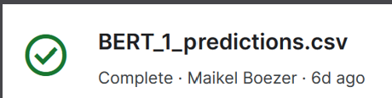



Biggest improvements
BERT model
Full dataset
lr=1e-5
ROBERTA model
Full dataset
Own label encoder
* These are results from the public leaderboard
Notes:
Biggest improvements
First with a BERT model that is trained on the full dataset with a learning rate of 0.00005, and after that with a ROBERTA model still trained on the full dataset but with its own label encoder.

Slide 8
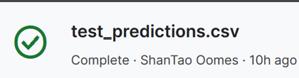
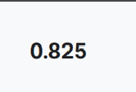
Best model
ROBERTA model
Go Emotions dataset
Weights
lr=1e-5
10.000 samples per emotion
* These are results from the public leaderboard

Slide 9
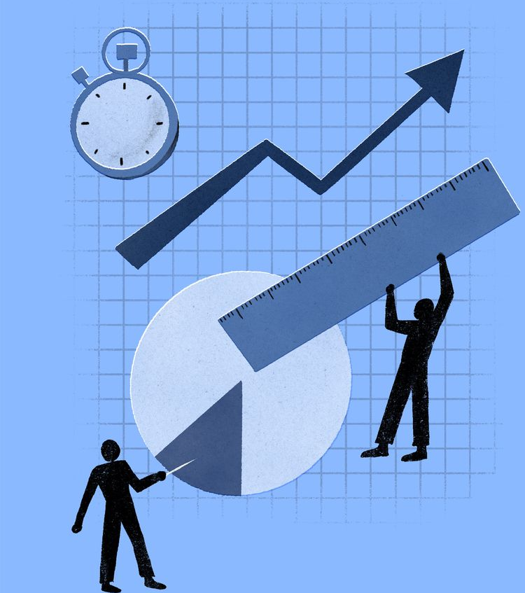
Metrics and Results: metrics
F1 Score
Recall
Precision
Accuracy
Notes:
F1 score:
Measures overall correctness of the model
Ratio of correctly predicted instances to total instances
Simple measure but may not be suitable for imbalanced datasets
Range: 0 to 1
Interpretation:
0 means completely inaccurate
1 means perfectly accurate
Precision:
Measures ratio of true positive predictions to total positive predictions
Indicates proportion of correctly predicted positive cases among all predicted positives
High precision means fewer false positives
Range: 0 to 1
Interpretation:
0 means no true positives (all predictions are false)
1 means perfect precision (no false positives)
Recall:
Measures ratio of true positive predictions to total actual positive instances
Indicates ability of the model to correctly identify all positive instances
High recall means fewer false negatives
Range: 0 to 1
Interpretation:
0 means misses all actual positive instances (all predictions are false negatives)
1 means perfect recall (no false negatives)
Recall:
Harmonic mean of precision and recall
Provides balance between precision and recall, considering both false positives and false negatives
Range: 0 to 1
Interpretation:
0 means poor precision and recall, or both
1 means perfect precision and recall

Slide 10
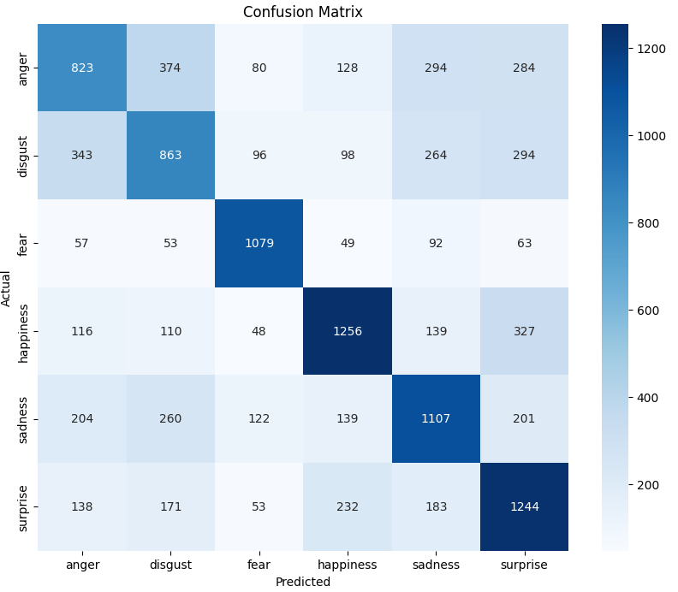
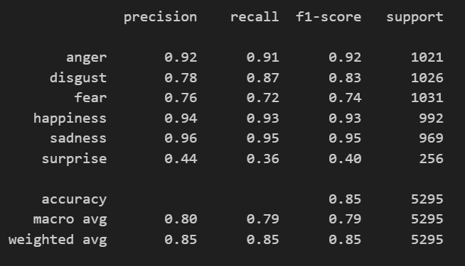
Metrics and Results of Model
Notes:
Precision, Recall, and F1-score:
The precision, recall, and F1-score are relatively high for most emotions, indicating that the model performs well in classifying these emotions.
Emotions like anger, disgust, fear, happiness, and sadness have high precision, recall, and F1-score, ranging from 0.92 to 0.96.
However, the model's performance is lower for surprise, with precision, recall, and F1-score of 0.44, 0.36, and 0.40, respectively.
Support:
The support column indicates the number of samples for each class in the dataset. The dataset appears to be balanced, with a similar number of samples for each emotion.
Overall Performance:
The accuracy of the model is 0.85, indicating that it correctly predicts the emotion in 85% of cases.
The macro and weighted average F1-scores are both relatively high at 0.79 and 0.85, respectively. This indicates that the model's performance is consistent across all classes and is not skewed by class imbalance.

Slide 11
Metrics and Results of Model
Sentence | True Label | Predicted Label
I'm so tired I read anti neurons as anti lemons for some reason | Sadness | Surprise
Be confident when you’re breaking the skin! If you hesitate, the vein is more likely to roll. | Fear | Disgust
im feeling tortured | Sadness | Anger
Notes:
The model may have misinterpreted the text as expressing surprise due to the unexpected or unusual association between "anti neurons" and "anti lemons". While the true emotion may be sadness, the model might have focused on the element of surprise conveyed by the unexpected reading.
The model might have misinterpreted the text as expressing disgust due to the mention of "breaking the skin", which could evoke imagery associated with injury or discomfort. Additionally, the warning about hesitating and the potential consequences might have further reinforced the model's prediction of disgust.
The model may have detected a sense of intense emotional distress in the text, which could have been interpreted as anger rather than sadness. While the true emotion may be sadness due to the mention of feeling "tortured", the model might have focused on the intensity of the emotion conveyed.

Slide 12
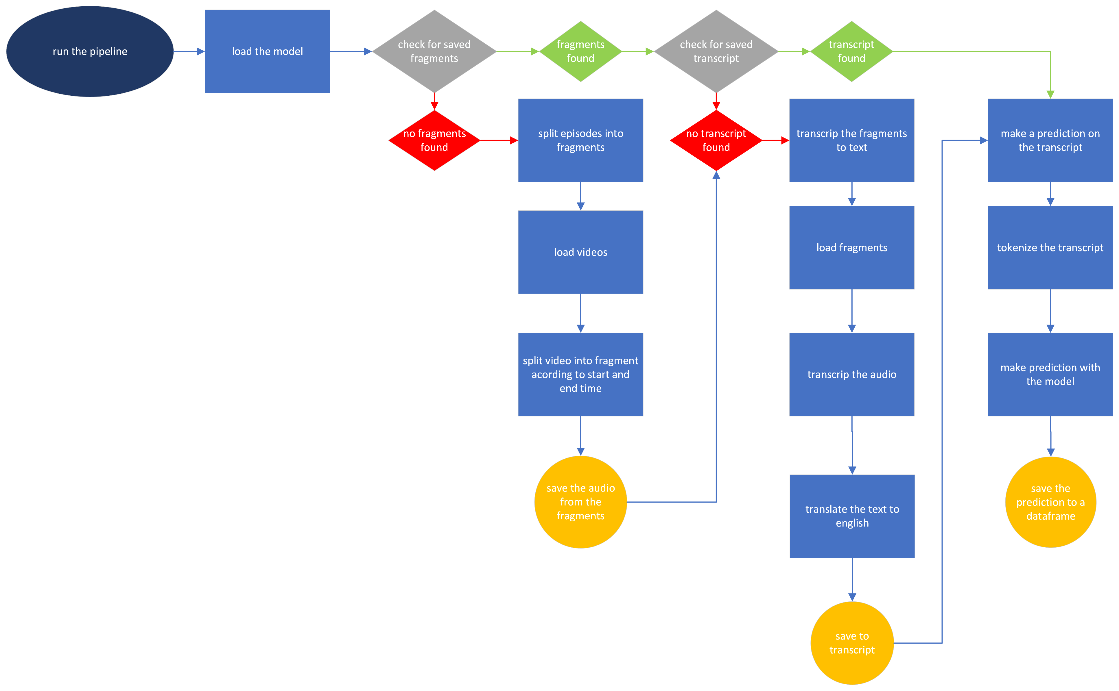
Pipeline
Notes:
Pipeline
When running the pipeline the first thing we do is load the model you saw in the previous slide, after that we run a check to see if there are already saved fragments from a previous run, if not then we start with splitting the episodes of experditie robinson into fragment, first load the videos then split the videos into fragments that we got the start and end times for from the data provided by 3rivers consultants and then save the audio from the fragments. After that, we load the fragments and start making a transcript of the audio, and while it is being transcribed it is also translated into English and finally, the transcript is saved. The last part of the pipeline is to get a prediction on the transcript but it still needs to be tokenized before that and save the prediction to a CSV file for analysis later

Slide 13
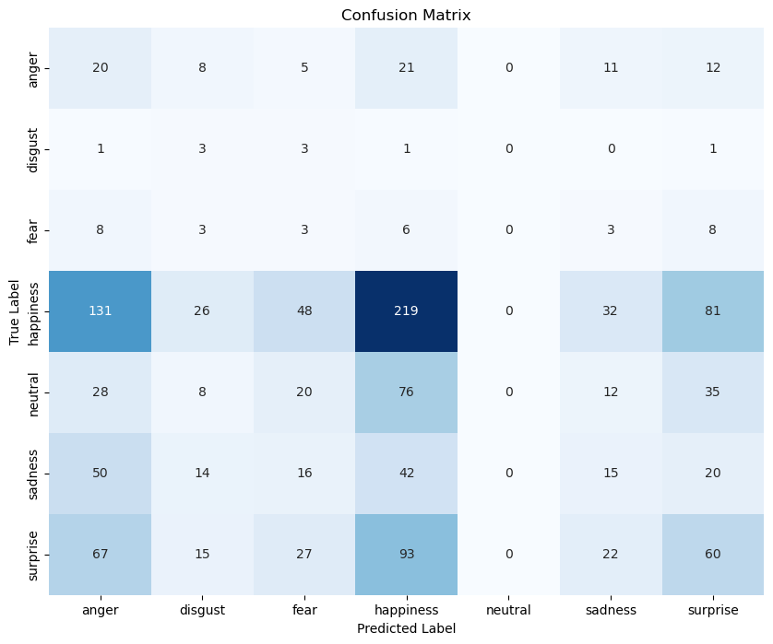
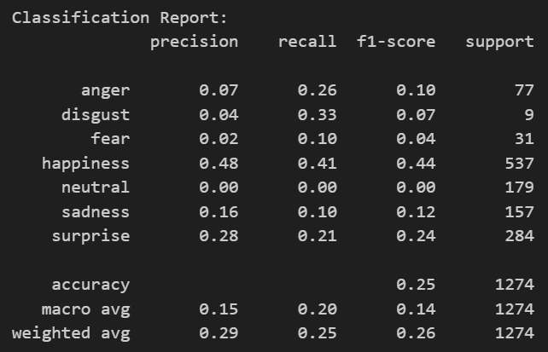
Metrics and Results of Pipeline
Notes:
Precision, Recall, and F1-score:
The precision, recall, and F1-score vary across different emotions. For example, the precision for happiness is relatively high at 0.48, indicating that when the model predicts happiness, it is correct 48% of the time. However, the precision for other emotions like anger, disgust, fear, and sadness is very low, ranging from 0.02 to 0.16, suggesting a high rate of false positives.
The recall values also vary, indicating how well the model captures instances of each emotion from the dataset. The recall for happiness, sadness, and surprise is relatively higher compared to other emotions.
The F1-score, which balances precision and recall, shows a similar pattern. Happiness has the highest F1-score at 0.44, followed by surprise at 0.24, while other emotions have lower F1-scores.
Support:
The support column indicates the number of samples for each class in the dataset. It appears that the dataset is imbalanced, with a significantly higher number of samples for happiness and a lower number for disgust, fear, and sadness. This class imbalance could affect the model's performance, especially for minority classes.
Overall Performance:
The accuracy of the model is 0.25, indicating that it correctly predicts the emotion in 25% of cases. While this accuracy is better than random guessing, it is relatively low, suggesting that the model's performance is limited.
The macro and weighted average F1-scores are both relatively low at 0.14 and 0.26, respectively. This indicates that the model's performance is poor across all classes, and it struggles to generalize well to unseen data.

Slide 14
Metrics and Results of Pipeline
Sentence | True Label | Predicted Label | F1 score
What is it? What is it? Helias Oja is an actor, a fan of the song and a player of the game. He knows him well from his role as an actor, from the 4th year of the show, Bokroma. Medo and Expedition Rob is a dream that comes true. It sounds like a cliché, but it really has a goal for me. I think I'm now a scientist, I'm an actor, I have one goal. And one goal is to Expedition Rob. So here we are. | Neutral | Happiness | 0.3094
Hi. Jiva Kousenou, the role of Robin in GTSD. I was forgotten by myself. After that, I presented three prizes and a little bit of space. I also went there. I always felt that I really made it. I had to live in the island and without telephone. And I was able to get back to nature. But I have to say that I have to live my life today. I am also in some things a little bit of a process. | Neutral | Sadness | 0.0431
Notes:
It seems like the content of the sentence involves someone talking about their aspirations and goals (becoming an actor, participating in a game show). The presence of positive words like "dream," "goal," and "scientist" might have led the model to predict happiness.
The sentence starts with a greeting followed by a statement about being forgotten by oneself, which could indicate introspection or a sense of being overlooked. The model might have interpreted this self-reflective tone as indicative of sadness. Additionally, words like "forgotten" and "live my life today" might have contributed to the prediction of sadness.

Slide 15

Limitations of BERT and RoBERTa
Strengths :
Contextual understanding
Versatility across NLP tasks
Enhanced Performance
Weakness:
Longer training times
Higher computational costs
Resource Dependency
Dataset can lead to bad results
Notes:
Strengths:
Contextual Understanding: RoBERTa effectively captures contextual information from text, enhancing its understanding of language semantics and relationships.
Versatility: The model performs well across various natural language processing tasks, including sentiment analysis and language understanding.
Enhanced Performance: it outperformed our BERT models, this is done by RoBERTa being trained on additional data sources including the ones used for BERT.
Limitations:
Longer training times: RoBERTa's bidirectional nature requires extensive pre-training on large datasets, resulting in longer training times and higher computational costs compared to unidirectional models.
Higher computational costs: The model's large size may pose difficulties in implementation, especially in settings with limited computational resources.
Resource Dependency: Effective utilization of RoBERTa depends on the availability of sufficient computing resources; its benefits may not be fully realized in resource-constrained environments.
BERT (whole dataset), RoBERTa (GoEmotions), RoBERTa (whole dataset) purity of the dataset

Slide 16
Conclusion
NLP
Emotion classification
Pipeline
Our limitations
Contribution

